Slide 1
Transaction level modelling
TLM2 based system models in practice

Slide 2
Agenda
Modelling at RTL level + hands-on (1h)
The need for higher levels of abstraction: why and how (30’)
Coffee break (15’)
TLM2 concepts: interfaces, sockets, coding styles (30’)
The loosely timed coding style + hands-on (1h)
Lunch (1h)
The approximately timed coding style + hands-on (1h15)
Coffee break (15’)
Interconnect and architectural exploration + hands-on (1h30)
ending notes: a real system, further information (30’)

Slide 3
Agenda
Modelling at RTL level + hands-on
The need for higher levels of abstraction: why and how
Coffee break
TLM2 concepts: interfaces, sockets, coding styles
The loosely timed coding style + hands-on
Lunch
The approximately timed coding style + hands-on
Coffee break
Interconnect and architectural exploration + hands-on
ending notes: a real system, further information

Slide 4
Modelling two communicating blocks: HDL abstraction level
Using signals to connect blocks
Notes:
A low level system-C implementation with two block doing a simple communication with signals

Slide 5
Modelling two communicating blocks: HDL abstraction level
Using signals to connect blocks
Example system:
Clock
clock
Master
Slave
start
done
resetn
Reset
Notes:
A low level system-C implementation with two block doing a simple communication with signals

Slide 6
Slave behaviour
Behaviour after reset (repeated) :
Wait for start signal
Deassert done and clear sum
Add 10 terms to the sum, one per cycle
Assert done

Slide 7
Master behaviour
Behaviour after reset:
Count 50 cycles
Start slave
Wait until slave is ready
Repeat 5 times

Slide 8
Implementation
example1
Toplevel
top.h
top.cpp
Slave : interface and implementation of the slave block
slave.h
slave.cpp
Master: interface and implementation of the master block
master.h
master.cpp

Slide 9
Hands-on : working with low level models
Modify the example:
Make start signal a 12-bit wide unsigned integer
Add the value of the start signal as an extra term to the sum
Add a 16-bit wide unsigned integer signal to transfer the resulting sum
Notes:
Took me about 20’ (+ 5’ Makefile adjustment, nicely printing results)

Slide 10
Structure of the examples
main.cpp
generic simulation set-up: sc_main function instantiating top modules and starting simulation
top.h top.cpp
interface and implementation of the example
public interface is generic
implementation is specific per example (every example instantiates and connects specific modules)

Slide 11
Structure of the examples: Makefile
Makefile targets:
clean
remove generated binaries (triggering full rebuild)
very_clean
remove more generated stuff (cleaning to original state)
build (default)
build example binary
run
run example binary

Slide 12
Hands-on preparation
Create and go to working directory
mkdir /scratch/<login>
cd /scratch/<login>
Get sources
tar xfz ~glasseem/tlm_course.tgz
cd tlm_course
Set-up environment
source tlm_course_setup.csh
Notes:
Solution in exercise1

Slide 13
Hands-on: possible implementation
exercise1
Toplevel
top.h
top.cpp
Slave :
slave.h
slave.cpp
Master:
master.h
master.cpp
Notes:
Deel 1 : 15’ example 1, 30’ hands-on werk, 15’ bespreking resultaten

Slide 14
Too detailed for real world blocks and systems
A real system: some memory-mapped registers
Clock
clock
read_ena
Master
write_ena
Slave
addr
write_data
read_data
ready
done
resetn
Reset
Notes:
Adding a memory mapped interface, low level,

Slide 15
Implementation
example2
Toplevel
top.h
top.cpp
Slave : interface and implementation of the slave block
slave.h
slave.cpp
Master: interface and implementation of the master block
master.h
master.cpp

Slide 16
Problems with this modelling style
You have to specify a full bus protocol
Spending a lot of thought on signals
Which signals
Signal width
Exact signal timing
You may want to interface through an off-the-shelve bus protocol (AHB, AXI, OCP, ...)
This may not be known yet (e.g. during architecture exploration)
A lot of inefficient development time
Signal toggling simulates slow

Slide 17
Agenda
Modelling at RTL level + hands-on
The need for higher levels of abstraction: why and how
Coffee break
TLM2 concepts: interfaces, sockets, coding styles
The loosely timed coding style + hands-on
Lunch
The approximately timed coding style + hands-on
Coffee break
Interconnect and architectural exploration + hands-on
ending notes: a real system, further information

Slide 18
Enter transaction level modelling
Blocks communicate with transactions over memory- mapped bus:
Write values to registers
Read values from registers
Trigger behaviour that requires an amount of time

Slide 19
TLM2 example system
Master
Slave
target
initiator
done

Slide 20
A TLM2 example : implementation
example3
Toplevel
top.h
top.cpp
Slave : interface and implementation of the slave block
slave.h
slave.cpp
Master: interface and implementation of the master block
master.h
master.cpp
Notes:
A tlm2 block with a couple of registers.

Slide 21
Transaction level modelling: use cases
Architecture exploration
Software development
( Verification)

Slide 22
Architectural exploration traditionally
Traditional HDL based design flows: too low level for architectural exploration:
Architectural level trade-offs are hidden in implementation detail
Design cycle is too long for exploring architectural options
Simulation times too long for exploration
Traditional solution:
Using back-of-the-envelop calculations, spreadsheets and drawings
“Gut” feeling, with safety margins.
Little room/time for architectural optimisation through exploration
Risks:
only local optimisations very far in the design process
a bad architectural choice is exposed very late, causing a long delay
a highly suboptimal design

Slide 23
Architectural exploration with TLM
Higher abstraction level allows for faster development, faster exploration of architectural options
The architectural choices more visible
Hard to estimate power accurately at this level
Good timing estimates are essential

Slide 24
Software development traditionally
Testing and debugging of software can only start when HDL simulation/emulation model/ actual hardware is available
This sequential flow leads to long time-to-market
Simulation is fairly slow, due to low level implementation details (pin wiggling)
Low-level debugging much harder
Emulation requires expensive hardware and tools

Slide 25
Software design using TLM
Due to high level of abstraction, the model can be available much earlier in the design phase
Debugging on higher abstraction layer is easier
Depending on abstraction layer, it simulates (much) faster
Need to maintain an additional model

Slide 26
Software development
HDL design
Back End
Software development
Specification
Integration
Traditional HDL based flow
HDL design
Back End
Software dev
Specification
Integration
TLM
TLM based flow
Notes:
Basic statement: Software dev can start much earlier and can go smoother because of faster simulations
Only works if TLM is indeed available much faster, and if the integration effort does not become bigger because of TLM/hardware inconsistencies
It should also allow more extensive testing of the design before sign-off
The additional advantage is that the TLM can serve as a reference/spec for the HDL, which is much more formal
A verification method around it supporting both

Slide 27
Different approaches to TLM
Define your own transaction level modelling API
C, C++, systemC based
Full control often leading to optimal simulation speed
No tool vendor dependence
No tool vendor support
Reuse of external models require lot of integration work
Use tool vendor API and models (e.g. Synopsys)
Good model availability for off-the-shelf components
Busses, processors, ...
Manual work to integrate models from other providers
Tool vendor dependence

Slide 28
Different approaches to TLM
TLM2 based modelling
Standardised interface: easy integration of external models
Good support in EDA tools (e.g. Synopsys, Cadence)
Open reference implementation available
No tool vendor dependence
Different coding styles for different levels of abstraction supported (loosely timed, approximately timed)
Combining models of different abstraction levels possible

Slide 29
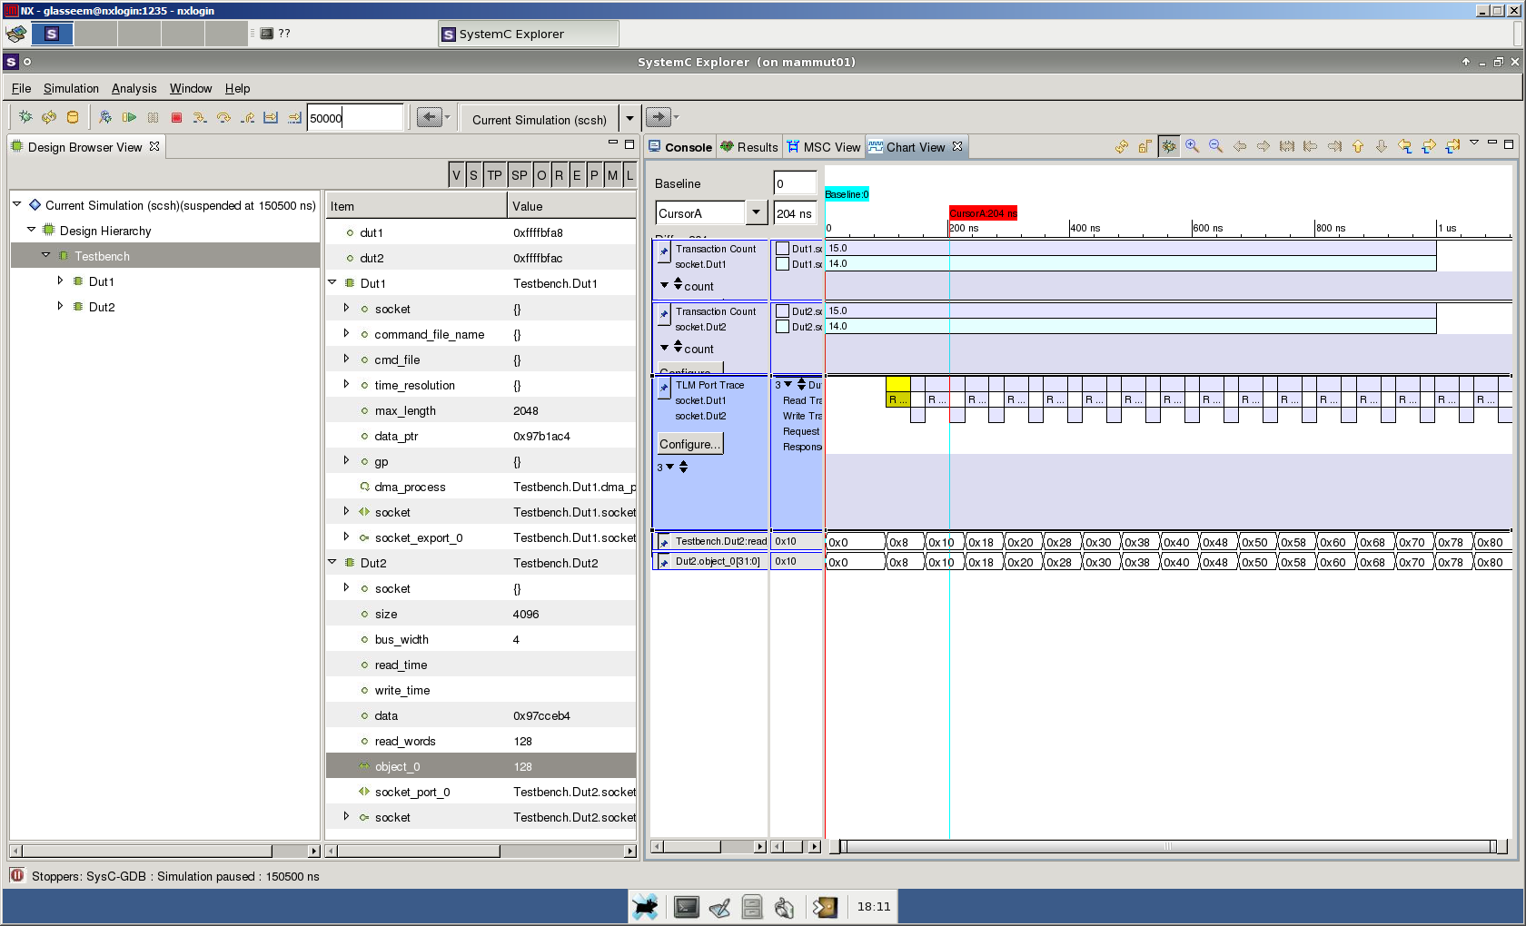
TLM2 in Synopsys

Slide 30
Virtual Platform Characteristics
Instruction Set Simulator | TLM | RTL
Available early | Available early | Much Later
Fast enough to run applications | Fast enough to run applications | Too slow to run applications
No/little hardware details | Register Accurate | Register and Pin accurate
No timing | Timing if needed | Cycle Accurate

Slide 31
Agenda
Modelling at RTL level + hands-on
The need for higher levels of abstraction: why and how
Coffee break
TLM2 concepts: interfaces, sockets, coding styles
The loosely timed coding style + hands-on
Lunch
The approximately timed coding style + hands-on
Coffee break
Interconnect and architectural exploration + hands-on
ending notes: a real system, further information

Slide 32
Agenda
Modelling at RTL level + hands-on
The need for higher levels of abstraction: why and how
Coffee break
TLM2 concepts: interfaces, sockets, coding styles
The loosely timed coding style + hands-on
Lunch
The approximately timed coding style + hands-on
Coffee break
Interconnect and architectural exploration + hands-on
ending notes: a real system, further information

Slide 33
SystemC terminology
Module
The basic building block of systems modelled in systemC
All other system components are incorporated within modules (including submodules)
May contain one or more processes
Interface
Abstract data type separating processing from communication
Implemented by one or more channels
Channel
Mechanism for communication between processes (of a single module or within different modules)
Implements one or more interfaces
Notes:
Interfaces are normative, coding styles not, sockets are bound to interface

Slide 34
SystemC terminology (ctd)
Port
Mediator for communication between modules
Indicates that the modules requires an interface
Forwards interface method calls up or out of the module
Class templated with the interface type
Export
Mediator for communication between modules
Indicates that the modules provides an interface
Forwards interface method calls down or into the module
Class templated with the interface
Notes:
Interfaces are normative, coding styles not, sockets are bound to interface

Slide 35
Terminology: example
Modules
Top
Clock
clock
Master
Slave
start
done
resetn
Reset
Notes:
Reusing the example to clarify systemC terminology: modules

Slide 36
Example revisited
example1
Toplevel
top.h
top.cpp
Slave : interface and implementation of the slave block
slave.h
slave.cpp
Master: interface and implementation of the master block
master.h
master.cpp
Notes:
Reusing the example to clarify systemC terminology: ports, interfaces, exports, signals.

Slide 37
TLM2 interfaces: the blocking transport interface template
Template interface defining
virtual void b_transport(TRANS & trans, sc_core::sc_time & t) = 0
References for simulation speed
Called in initiator, from a thread process
Implemented in target
Time parameter allows for “temporal decoupling”
Two timepoints per transaction
Time of call
Time of return

Slide 38
TLM2 Interfaces: the non-blocking transport interface templates
Forward interface template defining
virtual tlm_sync_enum nb_transport_fw (TRANS & trans, PHASE &ph, sc_core::sc_time & t) = 0
Called by initiator, in a method or thread process
Implemented in target module
Backward interface template defining
virtual tlm_sync_enum nb_transport_bw (TRANS & trans, PHASE &ph, sc_core::sc_time & t) = 0
Called by target in a method or thread process
Implemented in initiator module

Slide 39
TLM2 Interfaces: template arguments
Template parameter TRANS should be tlm_generic_payload for maximum compatibility
Template parameter PHASE should be tlm_phase for maximum interoperability
Defining the 4 timepoints of a transaction using the base protocol : BEGIN_REQ, END_REQ, BEGIN_RESP, END_RESP
For modelling exotic protocols, other template parameters are allowed, at expense of compatibility

Slide 40
Other TLM2 interfaces
Debug interface template defining
virtual unsigned int transport_dbg(TRANS &trans)=0
For debug accesses (without timing, without side effects )
Direct memory interface templates
Allowing an initiator to bypass interconnect and directly access the memory of a target
A forward interface defining
virtual bool get_direct_mem_ptr(TRANS &trans, tlm_dmi & dmi)=0
A backward interface defining
virtual void invalidate_direct_mem_pointer(sc_dt::uint64 start_range, sc_dt::uint64 end_range)=0

Slide 41
Combined TLM2 interfaces
TLM2 forward interface combines
Blocking transport interface
Non-blocking forward transport interface
Forward direct memory interface
Debug interface
TLM2 backward interface combines
Non-blocking backward transport interface
Backward direct memory interface

Slide 42
Sockets
Combine a port and an export
Target socket (tlm_target_socket)
An export providing the TLM2 forward interface
A port requiring the TLM2 backward interface
Initiator socket (tlm_initiator_socket)
A port requiring the TLM2 forward interface
An export providing the TLM2 backward interface
Binding an initiator socket to a target socket binds two port-export pairs
Required for TLM2 interoperability (in tlm namespace)
Buswidth as template parameter
Notes:
Combine port and exports, target socket, initiator socket, convenience socket

Slide 43
Convenience sockets a.k.a simple sockets
simple_initiator_socket<> and simple_target_socket<>
Derived from tlm_initiator_socket and tlm_target_socket respectively
Utilities for easier implementation (in tlm_utils namespace)
Not required for TLM2 compatibility
Provide automatic conversion between non-blocking and blocking transport calls (i.e. Requiring only one of both)

Slide 44
A target device
With plain socket
Module with target socket
Inherit from and implement forward transport interface tlm_fw_transport_interface (or create subclass for this)
Bind socket to this pointer (or to an object of the subclass)
With convenience socket
Module with target socket
Create member functions for transport callbacks
Register callback functions
Notes:
Plain socket: every callback has to be implemented, convenience socket convert blocking<->non-blocking if only one is provided

Slide 45
An initiator device
With plain socket
Module with initiator socket
Inherit from and implement backward transport interface tlm_bw_transport_interface (or create subclass for this)
Bind socket to this pointer (or to an object of the subclass)
Initiator thread uses forward interface calls to communicate with target modules
With convenience socket
Module with initiator socket
Create member functions for callbacks
Register callback functions
Initiator thread uses forward interface calls to communicate with target modules
Notes:
With convenience sockets, only the callbacks that will occur are needed

Slide 46
Generic Payload
Main content of transactions
Contains usual information for memory mapped bus systems:
Address
Data (for read and write)
Command (read, write, ignore)
Length
Streaming width
Byte enable
response
Extension mechanism available

Slide 47
Coding styles
Suggested approaches for modelling systems
Not required for TLM2 compliant models.
Two styles
Loosely timed coding style
Approximately timed coding style

Slide 48
Agenda
Modelling at RTL level + hands-on
The need for higher levels of abstraction: why and how
Coffee break
TLM2 concepts: interfaces, sockets, coding styles
The loosely timed coding style + hands-on
Lunch
The approximately timed coding style + hands-on
Coffee break
Interconnect and architectural exploration + hands-on
ending notes: a real system, further information

Slide 49
Loosely timed coding style
Appropriate for use cases only requiring coarse grain timing accuracy
Simple to implement
Only using blocking transports, but preferably without blocking
Using temporal decoupling
Limiting context switching
Fast simulations

Slide 50
Loosely timed coding style
Simulation time
Initiator
Target
b_transport(trans, 0 ns)
10 us
return(trans, 10 ns)
b_transport(trans, 40 ns)
return(trans, 60 ns)
...
b_transport(trans, 990 ns)
return(trans, 1000 ns)
wait(1000 ns)
b_transport(trans, 0 ns)
11 us
return(trans, 10 ns)
...

Slide 51
Loosely timed coding style example
example3
Toplevel
top.h
top.cpp
Slave : interface and implementation of the slave block
slave.h
slave.cpp
Master: interface and implementation of the master block
master.h
master.cpp

Slide 52
Hands-on: a system in loosely timed coding style
Starting with example3:
Split the TLM2 interface between a control and data interface
Data interface containing the values to be added
Control interface containing a register to start the slave, and a register to read back the result
Notes:
Took me 40’

Slide 53
Hands-on: possible implementation
exercise2
Toplevel
top.h
top.cpp
Slave :
slave.h
slave.cpp
Master:
master.h
master.cpp

Slide 54
Agenda
Modelling at RTL level + hands-on
The need for higher levels of abstraction: why and how
Coffee break
TLM2 concepts: interfaces, sockets, coding styles
The loosely timed coding style + hands-on
Lunch
The approximately timed coding style + hands-on
Coffee break
Interconnect and architectural exploration + hands-on
ending notes: a real system, further information

Slide 55
Agenda
Modelling at RTL level + hands-on
The need for higher levels of abstraction: why and how
Coffee break
TLM2 concepts: interfaces, sockets, coding styles
The loosely timed coding style + hands-on
Lunch
The approximately timed coding style + hands-on
Coffee break
Interconnect and architectural exploration + hands-on
ending notes: a real system, further information

Slide 56
Approximately timed coding style
Appropriate for use cases requiring fine grain timing accuracy
Harder to implement
Using non-blocking transports
More context switching
Simulating slower
Requires memory management for transactions

Slide 57
Approximately timed coding style
Simulation time
Initiator
Target
nb_transport_fw(trans, BEGIN_REQ,0 ns)
10 us
accepted
wait(10 ns)
10,010 us
nb_transport_bw(trans, END_REQ,0 ns)
accepted
wait(50 ns)
10,060 us
nb_transport_bw(trans, BEGIN_RSP,0 ns)
accepted
wait(40 ns)
10,100 us
nb_transport_fw(trans, END_RESP,0 ns)
accepted

Slide 58
Approximately timed coding style: early termination
Initiator
Target
nb_transport_fw(trans, BEGIN_REQ)
completed
nb_transport_fw(trans, BEGIN_REQ)
updated(trans, END_REQ)
nb_transport_bw(trans, BEGIN_RESP)
updated(trans, END_RESP)

Slide 59
Approximately timed coding style: pipelined transactions
Initiator
Target
nb_transport_fw(trans1, BEGIN_REQ)
updated(trans1, END_REQ)
nb_transport_fw(trans2, BEGIN_REQ)
updated(trans2, END_REQ)
nb_transport_bw(trans1, BEGIN_RESP)
updated(trans1, END_RESP)
nb_transport_bw(trans2, BEGIN_RESP)
completed(trans2)

Slide 60
Combining approximately timed and loosely timed models
Simple sockets take care of conversion
Accuracy limited by least accurate model (loosely timed)
Simulating time close to slowest model (approximately timed)
Reuse of models possible
Loosely timed initiator - approximately timed target: example4
Approximately timed initiator – loosely timed target: example5

Slide 61
Modelling an Approximately timed system
example6
Toplevel
top.h
top.cpp
Slave : interface and implementation of the slave block
slave.h
slave.cpp
Master: interface and implementation of the master block
master.h
master.cpp
Notes:
Same system as the original system, but in AT

Slide 62
Hands-on approximately timed coding style
Start from example 7:
Per iteration, all 10 registers of the sum are written consecutively
Change it so that they are written in a pipelined fashion.
Hints
In master, start next transaction after the end of the request, do not wait for end of response.
Wait for end of response before starting slave
Notes:
Write the slave registers in a pipelined fashion

Slide 63
Hands-on: possible implementation
exercise3
Toplevel
top.h
top.cpp
Slave :
slave.h
slave.cpp
Master:
master.h
master.cpp

Slide 64
Agenda
Modelling at RTL level + hands-on
The need for higher levels of abstraction: why and how
Coffee break
TLM2 concepts: interfaces, sockets, coding styles
The loosely timed coding style + hands-on
Lunch
The approximately timed coding style + hands-on
Coffee break
Interconnect and architectural exploration + hands-on
ending notes: a real system, further information

Slide 65
Agenda
Modelling at RTL level + hands-on
The need for higher levels of abstraction: why and how
Coffee break
TLM2 concepts: interfaces, sockets, coding styles
The loosely timed coding style + hands-on
Lunch
The approximately timed coding style + hands-on
Coffee break
Interconnect and architectural exploration + hands-on
ending notes: a real system, further information

Slide 66
Modelling interconnect
A bus model: basically containing one or more initiators and one or more targets, passing transactions from target to initiator.
A TLM2 interconnect model easily be parametrised to match a specific memory-mapped bus protocol (AHB, AXI, OCP, ...) by setting the correct timing parameters and limiting the amount of pending transactions.
Notes:
Modelling a bus

Slide 67
An example bus model
From example8
Bus model
bus.h
Connectivity defined in top
top.cpp
top.h

Slide 68
Architecture exploration
Slave1
target
initiator
Master
initiator
...
target
initiator
SlaveN
target
Notes:
What is the impact of maximum burst length, buswidth, on the overal system performance ?

Slide 69
Architecture exploration
Slave1
target
Number of slaves ?
Buswidth ?
Bus speed ?
Slave speed ?
...
initiator
Master
initiator
...
target
initiator
SlaveN
target
Notes:
What is the impact of maximum burst length, buswidth, on the overal system performance ?

Slide 70
Architecture exploration hands-on
From example9:
Investigate impact of number of slaves, bus width and bus timing parameters on total time

Slide 71
Agenda
Modelling at RTL level + hands-on
The need for higher levels of abstraction: why and how
Coffee break
TLM2 concepts: interfaces, sockets, coding styles
The loosely timed coding style + hands-on
Lunch
The approximately timed coding style + hands-on
Coffee break
Interconnect and architectural exploration + hands-on
ending notes: a real system, further information

Slide 72
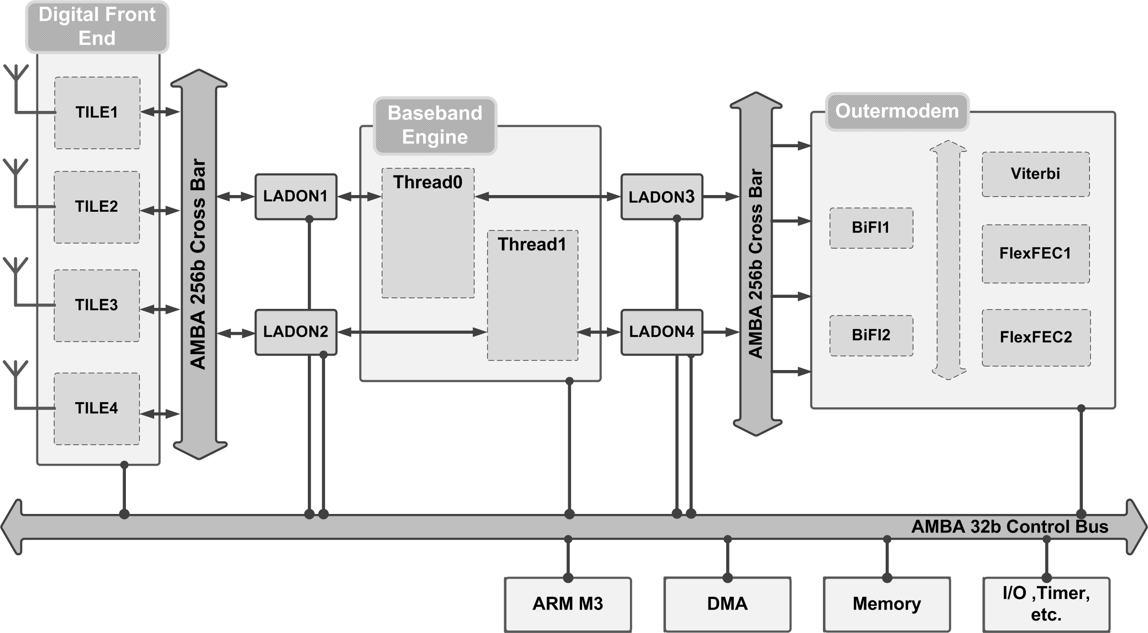
A real system: a wireless baseband system

Slide 73
Quantum keeper
Convenience utility to manage the amount of temporal decoupling (in tlm_utils namespace)
Class tlm_quantum_keeper
Static void set_global_quantum(const sc_time&)
Set time processes can run ahead
void inc(const sc_time&),void set(const sc_time&)
Increment local time, set local time
sc_time get_local_time(), sc_time get_current_time()
Get local time offset, Get total time
bool need_sync()
Local time offset exceeds quantum, sync needed
void sync()
Yield, i.e. wait until systemC time catches up

Slide 74
Payload event queue
Convenience utility for managing events associated with a transaction (in tlm_utils namespace)
Templated with transaction type (typically tlm_generic_payload)
Two types :
Class peq_with_get
Class peq_with_cb

Slide 75
Payload event queue
peq_with_get:
notify(TRANS &, const sc_time&) puts the event and the transaction on the queue to occur after the specified time
sc_event& get_event() returns event that will trigger
TRANS* get_next_transaction() returns transaction, or 0 if none
Class peq_with_cb_and_phase
Callback cb registered in constructor
notify(TRANS&, PHASE&, const sc_time&) puts event with associated transaction and phase in queue
cb(TRANS&, PHASE&) gets called when event occurs

Slide 76
Additional resources
The accellera website (www.accellera.org):
Former systemc.org
Open source systemC and TLM2 reference implementations
Including examples on approximately and loosely timed coding
Video tutorials
The systemC and TLM2 language reference manual (IEEE standard 1666-2011)

